Slide 2

Module Overview
Overview of Microsoft Web Technologies Overview of ASP.NET 4.5 Introduction to ASP.NET MVC 5
Notes:
20486A
01: Exploring ASP.NET MVC 4

Slide 3
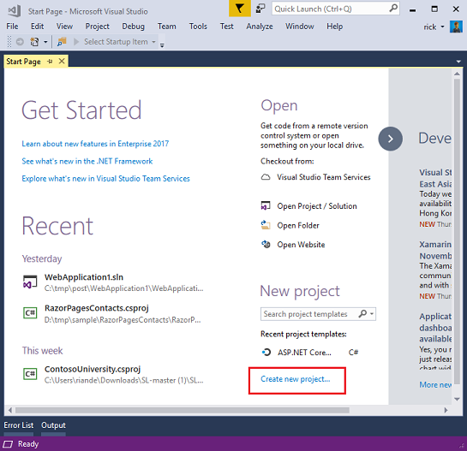
Lesson 1: Overview of Microsoft Web Technologies
Introduction to Microsoft Web Technologies Overview of ASP.NET 4.5 Client-Side Web Technologies Internet Information Server 8.0 Windows Azure
Notes:
20486A
01: Exploring ASP.NET MVC 4

Slide 4
Introduction to Microsoft Web Technologies
Develop
Host
Execute
Server-Side
Client-Side
Visual Studio Code
Visual Studio
Visual Studio Community
IIS
SQL Server
Microsoft Azure
SQL Database
ASP
NET CORE
MVC
WEB PAGES
WEB API
JavaScript
jQuery
AJAX
Kendo UI
Angular
Notes:
This topic is intended as a high level overview of the web stack. Use it to orient students and provide quick definitions of all the technologies on the slide. Do not go into depth. If you spend more than the intended 5 minutes for this topic, you might not be able to complete all the topics in this module within the scheduled time. Tell learners that subsequent topics and modules provide full details.
Developer Tools
Mention that WebMatrix 2 is the latest version of WebMatrix.
Orchard, Umbraco CMS, and WordPress are all popular web applications that provide content management facilities for small teams of users. Orchard and Umbraco are written in ASP.NET while WordPress is written in PHP.
Visual Studio 2012 is the latest version of Visual Studio. Students will use Visual Studio 2012 throughout this course to build a web application.
Code Execution Technologies
IIS 8 is the latest version of this technology and is included in Windows Server 2012.
Most websites require a database to store information such as product databases, user information, and discussion topics. In the labs, for example, you will build an application that stores photos in a database.
20486A
01: Exploring ASP.NET MVC 4

Slide 5
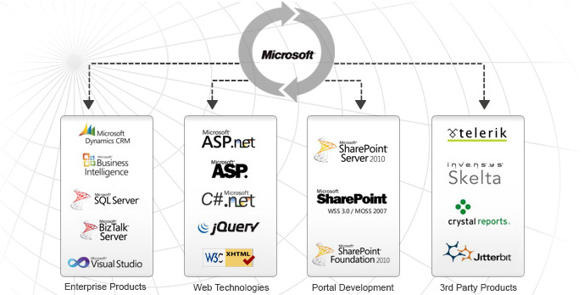
Introduction to Microsoft Web Technologies
Notes:
This topic is intended as a high level overview of the web stack. Use it to orient students and provide quick definitions of all the technologies on the slide. Do not go into depth. If you spend more than the intended 5 minutes for this topic, you might not be able to complete all the topics in this module within the scheduled time. Tell learners that subsequent topics and modules provide full details.
Developer Tools
Mention that WebMatrix 2 is the latest version of WebMatrix.
Orchard, Umbraco CMS, and WordPress are all popular web applications that provide content management facilities for small teams of users. Orchard and Umbraco are written in ASP.NET while WordPress is written in PHP.
Visual Studio 2012 is the latest version of Visual Studio. Students will use Visual Studio 2012 throughout this course to build a web application.
Code Execution Technologies
IIS 8 is the latest version of this technology and is included in Windows Server 2012.
Most websites require a database to store information such as product databases, user information, and discussion topics. In the labs, for example, you will build an application that stores photos in a database.
20486A
01: Exploring ASP.NET MVC 4

Slide 6
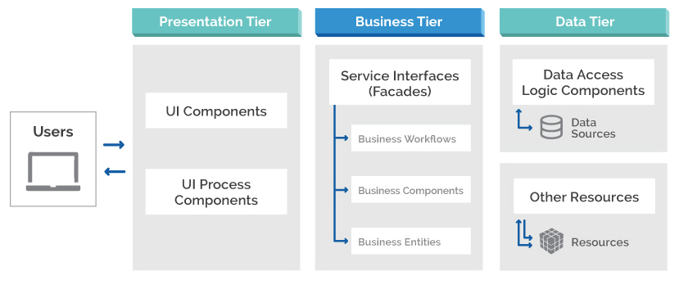
Base Architecture

Slide 7




Overview of ASP.NET 4.5
Programming Models
Web Pages
Web Forms
MVC
ASP.NET API
Configuration
Authentication and Authorization
Caching
Compiling ASP.NET Code
ASP.NET 4.5
HTML
Pages
Notes:
Use this topic as an overview of ASP.NET to orient the students and to introduce key terminology. These will be covered in greater detail in subsequent lessons and modules.
20486A
01: Exploring ASP.NET MVC 4

Slide 8
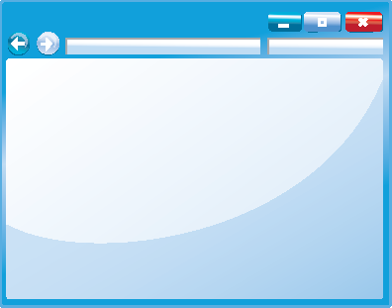

Client-Side Web Technologies
JavaScript
jQuery
jQuery UI
jQuery Mobile
AJAX
<p>
Content
</p>
p {
color: black;
}
Notes:
Emphasize that JavaScript underpins all the technologies described in this topic.
You will see how to link to a JavaScript library in Module 10. This course concentrates on jQuery but there are many alternative JavaScript libraries that provide similar facilities.
20486A
01: Exploring ASP.NET MVC 4

Slide 9

Internet Information Server 8.0
IIS
Features
Scaling
Perimeter Networks
IIS Express
Other Web Servers
Visual Studio Development Server
Notes:
You can find more information about all currently-supported versions and editions of IIS at:
http://www.iis.net
The Apache web server homepage can be found at: http://httpd.apache.org/
20486A
01: Exploring ASP.NET MVC 4

Slide 10

Windows Azure
What Is Microsoft Azure?
Web Sites
Web Services
SQL Database
Virtual Servers
Mobile Services
Media Storage
Notes:
You should ensure you are familiar with the latest features of Windows Azure before you teach this topic. You can create a trial Windows Azure user account and use it to create web sites, web services, databases, and so on. Explore the features of Windows Azure at http://www.windowsazure.com.
20486A
01: Exploring ASP.NET MVC 4

Slide 11
Lesson 2: Overview of ASP.NET 4.5
Web Pages Applications Web Forms Applications MVC Applications Discussion: ASP.NET Application Scenarios Shared ASP.NET Features
Notes:
All three programming models are described in this lesson. However, students will not see Web Pages or Web Forms in any further detail later in the course.
20486A
01: Exploring ASP.NET MVC 4

Slide 12
Web Pages Applications
Web Matrix or Visual Studio
Code in .CSHTML files
Precise Control of HTML
<h2>Special Offers</h2>
<p>Get the best possible value on Northwind specialty
foods by taking advantage of these offers:</p>
@foreach (var item in offers) {
<div class="offer-card">
<div class="offer-picture">
@if (!String.IsNullOrEmpty(item.PhotoUrl)){
<img src="@Href(item.PhotoUrl) alt="@item.Title" />
}
</div>
</div>
}
Notes:
Web Pages is designed as a simple server-side programming model that is quick to learn. Ensure that you have built a simple Web Pages application before you teach this topic so that you can highlight the differences between the programming models.
20486A
01: Exploring ASP.NET MVC 4

Slide 13
Web Forms Applications
Visual Studio only
Code in .aspx files and code-behind files
Create a UI by dragging controls onto a page
Controls provide rich properties and events
Bind controls to data
Notes:
Some of your students may be familiar with ASP.NET Web Forms because they have been present since ASP.NET was introduced. If many students are familiar with Web Forms, you may like to structure this topic as a discussion of the key features of this programming model. This will enable you to assess students’ knowledge.
20486A
01: Exploring ASP.NET MVC 4

Slide 14
MVC Applications
Models encapsulate objects and data
Views generate the user interface
Controllers interact with user actions
Visual Studio only
Code in .cshtml and .cs files
Precise control of HTML and URLs
Notes:
The MVC programming model should be new to the audience for this course.
20486A
01: Exploring ASP.NET MVC 4

Slide 15
Shared ASP.NET Features
Configuration
Authentication
Membership and Roles
State Management
Caching
Notes:
Students will learn more about authentication, membership, roles, and authorization in MVC applications in Module 11.
Students will see how to store and retrieve state information in Module 12.
Students will see how to correctly configure the ASP.NET Output, Data, and HTTP caches in Module 9.
20486A
01: Exploring ASP.NET MVC 4

Slide 16
Lesson 3: Introduction to ASP.NET MVC 5
Models, Views, and Controllers Demonstration: How to Explore an MVC Application New Features of ASP.NET MVC 4
Notes:
20486A
01: Exploring ASP.NET MVC 4

Slide 17

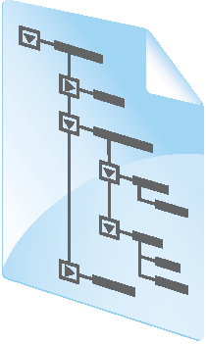


Models, Views, and Controllers
SQL
View
Model
Database
Controller
Web Server
HTTP
Browser
Notes:
Students will learn more about Entity Framework and data access in Module 2.
Students will learn more about the ASP.NET Routing Engine in Module 7.
20486A
01: Exploring ASP.NET MVC 4

Slide 18
New Features of ASP.NET MVC 4
ASP.NET Web API
Mobile Features
Display Modes
Asynchronous Controllers
OAuth and OpenID
Bundling and Minification
Notes:
Students will learn more about Web APIs in Module 14.
20486A
01: Exploring ASP.NET MVC 4

